Slide 1
Data Lake @AWS

Slide 2


AWS Network Topology – for Hadoop Cluster
VPC
Security Group
Public Sub net
Private Sub net
Edge Node
NAT Instance
Hadoop Cluster Box

Slide 3
VPC_ABIM_GG_LAB
VPC_SN_ABIM_GG_LAB_PUB
VPC_SN_ABIM_GG_LAB_PRIVATE
SG1_ABIM_GG_LAB_26OCT

Slide 4
AWS Network Topology – for Hadoop Cluster
VPC
Security Group
Public Sub net
Private Sub net
Edge Node
NAT Instance
DB Sub net
Hadoop Cluster Box
Dev Box
RDS-Oracle-Instance
EC2_ABIM_GG_LAB_DEV – Dev Box

Slide 5
Deployment Architecture for Hadoop Single Node Cluster
VPC – Virtual Private Cloud
Availability Zone
Security Group Layer
Public Sub net
Private Sub net
Dev Box
Edge Node
Hadoop Cluster Box
(Name Node/Data Node)
End User
DB Sub net
NAT Instance
RDS-Oracle-Instance
EC2_ABIM_GG_LAB_DEV – Dev Box

Slide 6
EC2_ABIM_GG_LAB_DEV
VPC_ABIM_GG_LAB
ABIM_GG_LAB
US-East-2c- Availability Zone
VPC_SN_DB_ABIM_GG_LAB
VPC_SN_ABIM_GG_LAB_PRIVATE
VPC_SN_ABIM_GG_LAB_PUB
SG1_ABIM_GG_LAB_26OCT
US-East-2b- Availability Zone
VPC_SN_ABIM_GG_LAB_PUB_AZ_2b

Slide 7
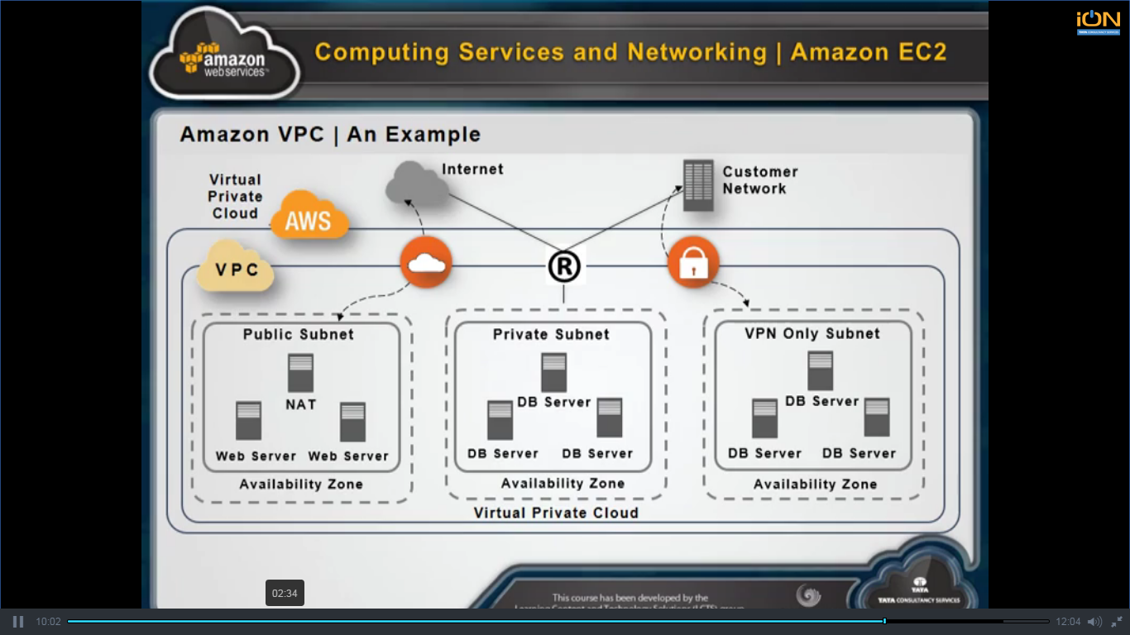
Reference

Slide 8

VPC_ABIM_GG_DEV
SG_ABIM_GG_DEV
Temporary link
ABIM_GG_DEV
US-East-2c- Availability Zone
VPC_SN_ABIM_GG_DEV_PUB
VPC_SN_ABIM_GG_DEV_PVT
VPC_SN_DB_ABIM_GG_DEV
SSH
EC2_ABIM_GG_DEV_Edge_node
EC2_ABIM_GG_DEV_HDP_cluster_pvt
SG_ABIM_GG_DEV_NAT_Instance
NAT_Instance_ABIM_GG_DEV
US-East-2b- Availability Zone
VPC_SN_ABIM_GG_DEV_PUB_AZ_2b

Slide 9
Data Architecture -

Slide 10
Table of Contents
Business Architecture
Functional Architecture
Logical Data Flow Diagram
Reference Solution Architecture
Data Governance using LIF (Lake Integration Framework)
Deployment Architecture for Hadoop Single Node Cluster
Sample Timeline
Use Cases

Slide 11



Business Architecture → Use Case → Reference Solution Architecture
Data Sources
Enterprise Data Store
Analytics
Various users
Data Lake - Hadoop Cluster
RDBMS
High Performance - Layer
Reports/ Dashboards
Structured
Data
Data Transformation
Any RDBMS
Predictive
Un-Structured
Data
Data Store
Semi- Structured
Data
Advanced Visualization

Slide 12
Business Architecture → Use Case → Reference Solution Architecture
<TBD using Visio>

Slide 13
Business Architecture → Use Case → Functional Architecture
Data Sources
Data Lake
RDBMS
High Performance - Layer
Analytics
Staging Area
Data Lake - Hadoop Cluster
Reports/ Dashboards
Data Ingestion
Data Validation & Cleansing
Joining, filtering & Transformation
Any RDBMS
Structured
Data
Security Layer
Security Layer
Predictive
Un-Structured
Data
Semi- Structured
Data
Advanced Visualization
Cluster Management
Orchestration
Data Governance

Slide 14
Business Architecture → Use Case → Functional Architecture
Data Sources
Data Lake
RDBMS
High Performance - Layer
Analytics
Staging Area
Data Lake - Hadoop Cluster
Reports/ Dashboards
Data Ingestion
Data Validation & Cleansing
Joining, filtering & Transformation
Any RDBMS
Structured
Data
Security Layer
Security Layer
Predictive
Un-Structured
Data
Semi- Structured
Data
Advanced Visualization
Cluster Management
Orchestration
Data Governance

Slide 15
Logical Data Flow Diagram
Data Sources
Structured
Semi-Structured
Data Ingestion
Batch - Historical
Real time - Messaging
Validation & Processing
Rule Engine
Customization
Unstructured
Joining and Merging (for 360 view)
Data Consumption
Reports /Dashboards
Visualization
Predictive Analytics
Batch - Incremental

Slide 16
Reference Solution Architecture
Orchestration
Metadata Management - Java/HTML5/Jquery/Angular JS
Data Extraction
Data Ingestion
Data Analytics & Visualization
Security
Governance, Risk & Compliance
Datameer
QlikView
Pentaho BA
Others
Identity Management
Active Directory
Java/Python
ETL
Data Access
Hive
webHDFS
Cloudera Search
Others
ETL
Authentication
Kerberos/LDAP
Auditing Component
Data Storage & Processing
Streaming
Map Reduce
Spark
SOLR
Flume
Resource Management (YARN)
Authorisation
Sentry
HDFS
Monitoring & Administration
Monitoring
Cluster Admin Manager

Slide 17
Data Governance using LIF (Lake Integration Framework)
Building Blocks
Lake Integration Framework - Layers
Enterprise Data Lake
Ingest
Data Quality
Data Lineage
Auditing & Monitoring
Transform & Process
Orchestration
Metadata Management
Orchestration & Processing Layer
Data Storage
Data Persistence Layer
User Interface Layer

Slide 18
Deployment Architecture for Hadoop Single Node Cluster
VPC – Virtual Private Cloud
Availability Zone
Security Group Layer
Public Sub net
Private Sub net
Dev Box
Edge Node
Hadoop Cluster Box
(Name Node/Data Node)
End User
DB Sub net
NAT Instance
RDS-Oracle-Instance
EC2_ABIM_GG_LAB_DEV – Dev Box

Slide 19
Sample Timeline
Due Diligence
Migration
Transformation – Phase 1
Transformation – Phase 2
Transformation – Phase 3

